Slide 1


BBA Program
BUS102
Fall 2023
Overviews of:
Finance, Financial Environment &
Financial Management

Slide 2
A few Simple Questions
You received Tk100,000 as a gift from your grannies and want to invest it for the next 5 years before you go abroad for higher studies.
  What are your choices?
  What matters will you consider in making your choice?
You need Tk100,000 to pay your tuition fee that you do not have now.
  What are your choices?
  What matters will you consider in making your choice?

Slide 3
A few Simple Problems and Questions
Suppose you put Tk10,000 in a deposit account at BRAC Bank.
  How much you expect to receive after 5 years if you earn 10% simple interest annually?
  How much you expect to receive after 5 years if you earn 10% interest compounded annually?

Slide 4
A few Simple Problems and Questions
Suppose you can buy a Shanchaypatra and earn 10% interest compounded annually for 5 years, or
You can make a deposit at BRAC Bank and earn 10% interest compounded annually for 5 years.
  Which saving/investment will you prefer? Why?
Suppose you are deciding whether to invest in META or in TSLA and have collected the following info:
  Which stock will you prefer? Why?
Stock | Expected Return | Expected Risk
META | 15% | 10%
TSLA | 20% | 15%

Slide 5
Major Topics of Discussion
What is Finance?
Major Fields of Finance
Interrelationships with other Fields of Business Administration
Career Opportunities in Finance
Essential Knowledge, Skills and Abilities for Success

Slide 6
Major Topics of Discussion …
Overview of the Financial Environment
  Capital Allocation Process and Interest Rate Determination
  The Components of the Financial System and their Roles
    Financial Securities
    Financial Institutions / Intermediaries and
    Financial Markets

Slide 7
Major Topics of Discussion …
Overview of Financial Management
  The Value Maximization Objective of the Corporation, Agency Conflicts, Corporate Social Responsibility (CSR), Corporate Governance, etc.
  Financial Management – 2 Major Functions:
    Investment Decisions and
    Financing Decisions
  Ethical Issues for Finance Professionals

Slide 8
What is Finance? Who Cares?!
Finance is the art and science of managing money.
It involves fund transfer and re-distribution processes - involving instruments, platforms, infrastructure, institutions and people (entrepreneurs, investors, managers, dealers, regulators, and more) that facilitate the transfer of money between entities.
It is associated with and shaped by human sentiments, attitude and behavior (and spirit!) - rational, irrational, wild and crazy, greed and deception, animal instincts, and much more…
Everyone cares: All entities (individuals, households, businesses, governments) earn/raise and spend/invest money and want to enhance utilities/welfare.

Slide 9
Finance: Fundamentals
At all levels and for everyone, sound financial decision-making are essential at – both at individual and collective (business/organization and macro-economy) levels
To make rational financial decisions, we must understand three simple, general and very reasonable, concepts: everything else equal,
  More return is preferred to less;
  The sooner cash is received, the more valuable; and
  Less risky assets are preferred to riskier assets.
Ethics is very critical in finance (as in life!)

Slide 10
Major Fields of Finance
Personal Finance
Financial Management / Managerial/Corporate Finance
Financial Markets and Institutions / Finance Services
Investments and Behavioral Finance
Financial Derivatives and Engineering & Risk Management
International Finance

Slide 11
Interrelationships of Finance with other Fields of
Business Administration
Economics
Accounting
Management (including HRM and Strategy)
Marketing and Entrepreneurship
Operations and Supply Chain Management
Information Systems & Technology

Slide 12
Career Opportunities in Finance
Careers in finance typically fall into one of two broad categories:
  Financial services and
  Managerial finance
Financial services is the area of finance concerned with the design and delivery of financial products and advice to individuals, businesses, and governments. It involves a variety of interesting career opportunities within the areas of:
  Banking
  personal financial planning
  Investments
  Real estate
  Insurance
  Etc.

Slide 13
Career Opportunities in Finance
Managerial finance is concerned with the duties of the financial manager working in a business. Financial managers administer the financial affairs of all types of businesses: private and public, large and small, profit seeking and not for profit. They perform such varied tasks:
  Developing financial plan or budget
  Managing cash, credits, inventory, etc.
  Evaluating proposed large expenditures
  Raising money to fund the firm’s operations.

Slide 14
Career Opportunities for BBA Finance Majors in Bangladesh
Sl. | Company Name | Position | Educational Requirements | Experience Requirements | Salary
1. | Robi | Specialist | BBA/MBA in Accounting/Finance | Freshers | Negotiable
2. | Dutch-Bangla Bank Ltd | Management Trainee Officer (MTO) | Masters in any discipline |  | 55,000/-
3. | IDLC | Management Trainee-Investment Banking | BBA/MBA- Finance | Freshers | Negotiable
4. | Bangladesh Finance Limited | Relationship Officer/ Senior Relationship Officer | Post-graduation in Business Studies. | 0-1year(s) | Negotiable
5. | Pran | Business Development Executive | MBA/BBA or equivalent degree in Business Studies | 0-1 year(s) | Negotiable
6. | Daraz | Executive- Finance | BBA major in Finance | 0-1 years | Negotiable
7. | Marico | Executive-Finance | Bachelors in Finance | 1 year | Negotiable
8 | BKash | Officer/ Sr. Officer | Graduation in Economics & Finance | 1-3 years | Negotiable
9. | Swisscontact Bangladesh | Officer/Senior Officer - Finance | A bachelor's degree in Finance, Accounting, Business Administration | 1 -3 year(s) | Negotiable
10 | Dekko Isho | Executive/ Sr. Executive (Finance & Accounts) | Masters / MBA in Accounting/ Finance | 1 -4 year(s) | Negotiable
11 | Bengal Commercial Bank Limited | Trainee/ Assistant Relationship Officer, Micro Credit Program | Masters in any discipline | 2 year(s) | Negotiable
12 | Save the Children | Officer- Finance | M.Com/ MBA in Accounting/Finance | 3 year(s) | Negotiable

Slide 15
Career Opportunities for BBA Finance Majors in Bangladesh
Sl. | Company Name | Position | Educational Requirements | Experience Requirements | Salary
13 | ACI | Senior Executive - Accounts & Finance | BBA and MBA majoring in Accounts/ Finance | 2-4 year(s) | Negotiable
14 | The ACME Laboratories Limited | Executive - Finance & Accounts (API Project) | MBA/BBA or equivalent degree in Business Studies (Accounting or Finance) | 3-5 year(s) | Negotiable
15 | Roxy Paints Limited | Assistant Manager - Accounts & Finance | MBA/M.Com in Accounting/Finance | 3-5 year(s) | 30000 - 35000
16 | IPDC | Relationship Manager | Bachelor degree in Finance | 3-7 year(s) | Negotiable
17 | Meena Bazar | Assistant Manager | M.B.A. in Accounts or Finance | 4-6 year(s) | Negotiable
18 | Asiatic Marketing Communications Limited | Associate Manager/Manager - Finance & Accounts | MBA/MSC, BBA/BSC in Finance & Accounts from reputed University | 5-7 year(s) | Negotiable
19 | BRAC Enterprises | Manager/ Sr. Manager, Finance & Accounts | MBA/M. Com in Accounting and Finance | 8 year(s) | Negotiable
20 | IPDC Finance Limited | Head of Business Finance Credit | Bachelor of Business Administration (BBA) | 7-9 year(s) | Negotiable
21 | ASA | Assistant Director (Finance & MIS) | Masters with Honors in Accounting/Finance/AIS/MIS | 10 year(s) | Negotiable
22 | Ring Shine Textiles Limited | Chief Financial Officer (CFO) | Masters/ MBA in Finance or Accounting and qualified or partly qualified of CFA/CPA/CA/CMA/CCA | 10 year(s) | Tk. 83000 (Monthly)

Slide 16
Essential Knowledge, Skills and Abilities for Success in Finance
Understanding of basic concepts and principles
Qualitative and quantitative skills
Problem-solving skills
Analytical ability
Data analytics
Ethics
Professional Certifications
  Chartered Financial Analyst (CFA): offered by the CFA Institute, the CFA program is a graduate level course of study focused primarily on the investments side of finance; and many others.
  Certified Financial Planner ® (CFP®), Certified Fund Specialist (CFS), Chartered Financial Consultant (ChFC), Chartered Investment Counselor (CIC) and many others

Slide 17
An Overview of Financial Environment/System
A well-functioning / efficient financial system is essential for stable economic growth.
  Allocational Efficiency: Funds/capital flow from savers/lenders to users/borrowers efficiently for most productive uses.
  Operational Efficiency: Funds/capital flow from savers/lenders to users/borrowers efficiently at low transaction cost.
  Informational Efficiency: Security prices reflect all available info and react to new information quickly and fully.

Slide 18
Transfer of Capital from Savers to Borrowers
Direct transfer (e.g., corporation issues commercial papers to insurance companies or shares to investors)
Indirect transfer: through an investment banking house (e.g., IPO, seasoned equity offering, or debt placement). Investment banks merely transfer securities (claims) for a margin/fees.
Indirect transfer: through a financial intermediary (e.g., individual deposits money in bank, bank makes commercial loan to a company). Financial intermediaries create their own securities (claims).

Slide 19
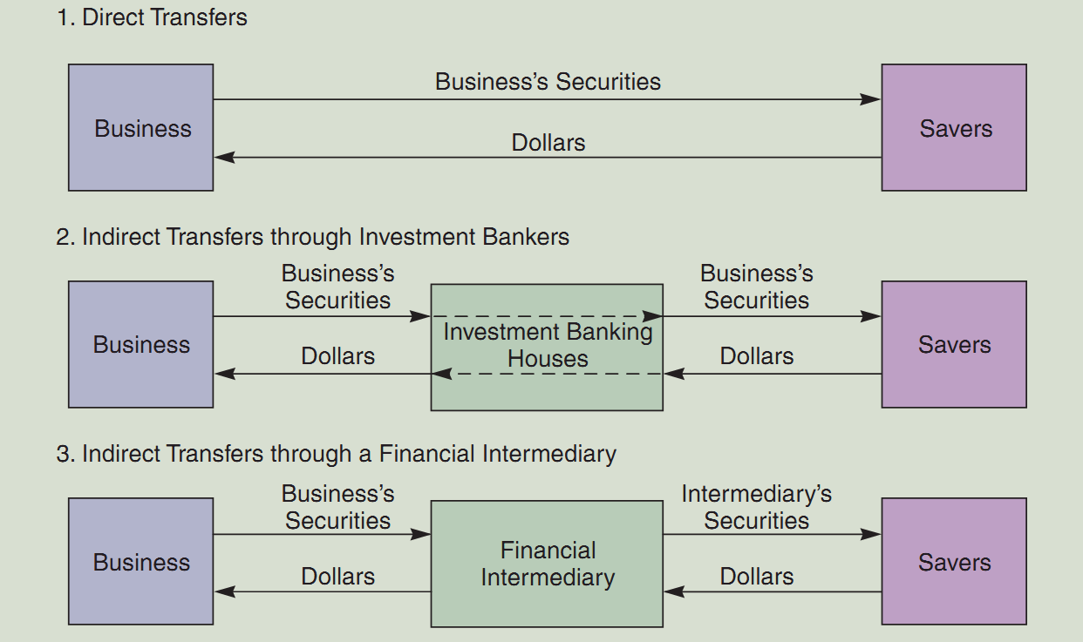
Transfer of Capital from Savers to Borrowers

Slide 20
What are Some Financial Institutions?
Commercial banks
Investment banks – Specialized financial institutions (or division of banks) that assist in raising and management of capital and provide advisory services. They do underwriting, M&A consulting, wealth management for individuals/institutions.
Investment funds / companies
  Mutual Funds (open) and Exchanged Traded Funds (ETFs)
  Hedge funds - Small number of large investors invests in many securities including derivatives)
Private equity funds - Small number of investors typically owns virtually all shares in a firm).
Life insurance companies
Pension funds

Slide 21
Financial Securities
Financial securities are pieces of paper (or even computer entries) with contractual provisions that entitle their owners to specific rights and claims (ownership/creditor) on specific cash flows.
Notice that debt and equity represent claims upon the cash flows generated by real assets, such as the cash flows generated by a firm’s factories and operations.

Slide 22
Financial Securities
 | Debt | Equity | Derivatives
Money Market (short-term maturity, less than 1 year) | T-Bills CD’s Eurodollars Fed Funds |  | Options Futures Forward
Capital Market (long-term maturity, more than 1 year) | Govt. Bonds Agency bonds Municipals Corporate bonds | Common Stock Preferred stock | Swaps Options Futures Forward

Slide 23
Financial Markets
A market is a place (physical or virtual) of exchanging one asset (usually cash) for another asset.
Types of financial markets
  Physical assets vs. financial assets
  Money versus capital markets
  Spot versus future markets
  Primary versus secondary markets

Slide 24
Cost of Money / Fund / Capital
What do we call the price, or cost, of debt capital?
  The interest rate
What do we call the price, or cost, of equity capital?
  Cost of equity = Required return = dividend yield + capital gain
Certain fundamental economic factors, economic conditions and policies, and international factors affect the demand and supply of loanable funds and their cost.

Slide 25
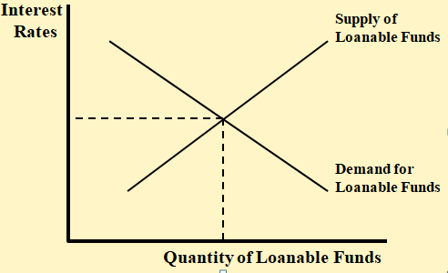
Loanable Funds Theory of Equilibrium Interest Rate
Aggregate Demand: D_{A} = D_{h} + D_{b} + D_{g} + D_{f}
Aggregate Supply: S_{A} = S_{h} + S_{b} + S_{g} + S_{f}
In equilibrium, D_{A} = S_{A}

Slide 26
Fundamental Factors Affecting the Cost of Money
Production opportunities – ability to turn capital into benefits. The benefits are determined by the expected rates of return on its production opportunities.
Time preferences for consumption
Risk (of return on investment / cash flows)
Expected inflation

Slide 27
Economic Conditions and Policies Affecting the Cost of Money
Level of individual income and expenditures
Level of business activities (recession or boom)
Central Bank (Federal Reserve/Bangladesh Bank) Policies:
  Open market operation
  Discount lending
  Reserve requirement
Budget deficits/surpluses
International trade deficits/surpluses

Slide 28
International Conditions Affecting the Cost of Money
Country risk: Risk that arises from investing or doing business in a particular country, and it depends on the country’s economic, political, and social environment.
Exchange rate risk: Non-native currency denominated investment’s value depends on what happens to exchange rate. Exchange rates affected by:
  International trade deficits/surpluses
  Relative inflation and interest rates
  Relative growth rates

Slide 29
Financial Management
Part of finance that deals with decisions as to how to raise and use money to maximize value. In a corporate business setting, Financial Management is often termed as Corporate Finance.
A business that practices sound financial management can provide better products to its customers at lower prices, pay higher salaries to its employees, and still provide greater returns to investors who put up the funds needed to form and operate the business.
Because the economy — both national and worldwide — consists of customers, employees, and investors, sound financial management contributes to the well-being of both individuals and the general population.

Slide 30
The Value Maximization Objective
If an objective is not chosen, there is no systematic way of making and evaluating decisions.
An objective should be (1) clear and unambiguous, (2) easily measureable (timely feedback), and (3) should not be socially costly.
Correct Objective of Effective Financial Management
  Maximizing customer satisfaction?
  Maximizing size of the firm?
  Maximizing market share (sales)?
  Minimizing costs/maximizing profits or earnings per share?
  Maximizing Return on Asset (ROA) / Return on Investment (ROI)?
  Maximizing firm value/shareholder value/shareholder wealth

Slide 31
Management’s Primary Objective
The primary objective should be shareholder wealth (value) maximization, which, under certain conditions, translates to maximizing stock price.
  When market price of shares reflect all relevant information, then the observed price is the same as the intrinsic/fundamental value of shares.
  There may be conflict of interests between stockholders and managers; agency problem. Sometimes managers take deliberate steps (illegal or legal) to influence market price of shares artificially.

Slide 32
What Determines a Firm’s Fundamental, or Intrinsic, Value?
Intrinsic (fundamental) value of a firm is the sum of all the future expected free cash flows when converted into today’s dollars:

Slide 33
Managerial Actions to Maximize Firm/shareholder Value
The cash flows that matter are called free cash flows (FCF)
  Amount of expected cash flows (bigger is better)
  Timing of the cash flow stream (sooner is better)
  Risk of the cash flows (less risk is better)

Slide 34
Free Cash Flows (FCF)
Free cash flows are the cash flows that are available (or free) for distribution to all investors (stockholders and creditors).
  FCF = sales revenues - operating costs - operating taxes - required investments in operating capital.

Slide 35
What is the Weighted Average Cost of Capital (WACC)?
To generate cash flows, managers must decide how to finance projects and operations of the firm.
WACC is the average rate of return required by all of the company’s investors.
WACC is affected by:
  Capital structure (the firm’s relative mix of debt and equity)
  Interest rates
  Risk of the firm’s operations
  Investors’ overall attitude toward risk

Slide 36
Management’s Primary Objective & Corporate Social Responsibility (CSR)
How about other stakeholders?
  Aside from such illegal actions as fraudulent accounting, exploiting monopoly power, violating environmental safety codes, the same actions that maximize stock values also benefit society.
    To a large extent, the owners of stock are society:
    Consumer benefits: Firms that maximize stockholder value must produce high quality goods and services at the lowest possible cost; charge reasonable price (high consumer value). Price is constrained by competition and consumer activism.
    Employee benefits: Employment growth is higher in firms (attract, develop and retain) that try to maximize stock value.
  In summary, it is difficult for firms to maximize share price without paying heed to other stakeholders’ wellbeing. Therefore, the firms should preserve to maximize shareholders wealth.
  Financial Decision-making must strive for sustainable development benefitting the society-at-large.
Notes:
Society now has important direct or indirect stakes in the stock market. Institutional investors such as pension funds, insurance firms and mutual funds own more than 61% of all US stock. In addition, more than 47% of US households now own stock or bonds directly.

Slide 37
Agency Conflict: Between Managers and Stockholders
Managers are naturally inclined to act in their own best interest (which is not always the same as the interest of stockholders).
Principal-Agent Relation: The Agency Problem – The potential conflict of interest between the principal (owners/shareholders) and agent (managers) .
Appropriate Compensation and Market forces help mitigate the agency problem:
  Managerial compensation packages tied to stock price
  Direct intervention by (major) shareholders
  The threat of takeover

Slide 38
Conflicts Between Stockholders and Bondholders
Stockholders are more likely to prefer riskier projects, because they receive more of the upside if the project succeeds. By contrast, lenders/bondholders receiving fixed payments are more interested in limiting risk.
Lenders/Bondholders are particularly concerned about the use of additional debt.
Lenders/Bondholders attempt to protect themselves by including covenants in bond agreements (indenture) that limit the use of additional debt and constrain managers’ actions.

Slide 39
Conflict of Interests and
Corporate Governance
Corporate governance can help control potential conflict of interests between stockholders and managers and between stockholders and bondholders.
Corporate governance is the set of rules that regulates a company’s behavior towards its directors, managers, employees, shareholders, creditors, customers, competitors, and community.

Slide 40
Balance Sheet Model of the Firm and Financial Decisions
  Total Value of Assets:
  Total Firm Value to Investors:
Current Assets
Current Liabilities
Long-Term Debt
Shareholders’ Equity
Fixed Assets
1 Tangible
2 Intangible
Notes:
It is sometimes helpful to relate corporate decisions to individual circumstances. For example, consider discussing how individuals choose to buy cars or homes and how this decision would affect a personal balance sheet.

Slide 41
Short-Term Asset Management
Current Assets
Current Liabilities
Net Working Capital
Long-Term Debt
  How should short-term assets be managed and financed?
Fixed Assets
1 Tangible
2 Intangible
Shareholders’ Equity

Slide 42
The Capital Budgeting Decision
Current Assets
Current Liabilities
Long-Term Debt
Fixed Assets
1 Tangible
2 Intangible
  What long-term investments should the firm choose?
Shareholders’ Equity

Slide 43
The Capital Structure Decision
Current Assets
Current Liabilities
Long-Term Debt
How should the firm raise funds for the selected investments?
Fixed Assets
1 Tangible
2 Intangible
Shareholders’ Equity

Slide 44
Ethical Issues for Finance Professionals
Financial managers prepare reports, oversee accounting functions, plan investment strategies and direct cash management functions. They also are involved in branch management functions at banks and other financial institutions.
They are required to uphold the highest ethical standards because internal and external stakeholders depend on transparent, timely and complete financial documents to make decisions.

Slide 45
Ethical Issues for Finance Professionals
Financial advisors manage assets and money matters for individuals who often have less knowledge and savvy about the markets and finance in general.
They must undertake ethical transaction. It occurs when a client truly understands the ramifications of the advisor’s recommendations and is willing to go forward, assuming that all pertinent laws and regulations are being obeyed.

Slide 46
Questions? / Comments?
Welcome!

Slide 47
A few Simple Problems and Questions
Suppose you put Tk10,000 in a deposit account at BRAC Bank.
  How much you expect to receive after 5 years if you earn 10% simple interest annually?
  TK10,000 + TK10,000 (0.10) (5) = TK15,000.00
  How much you expect to receive after 5 years if you earn 10% interest compounded annually?
TK10,000 (1.10)⁵ = TK16,105.10

